Slide 1
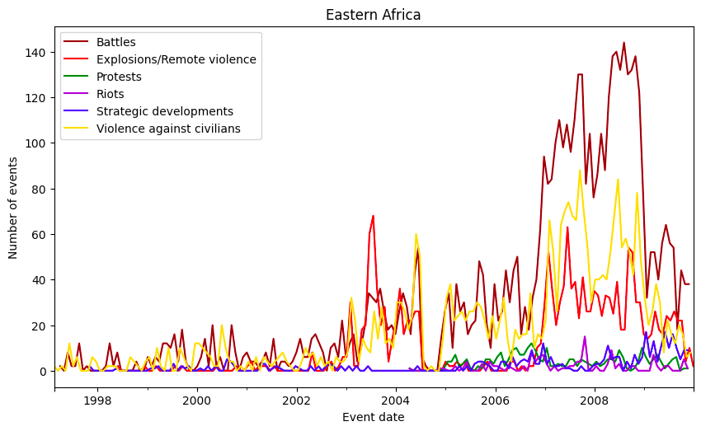
Weather, conflicts and IDPs in Somalia

Slide 2
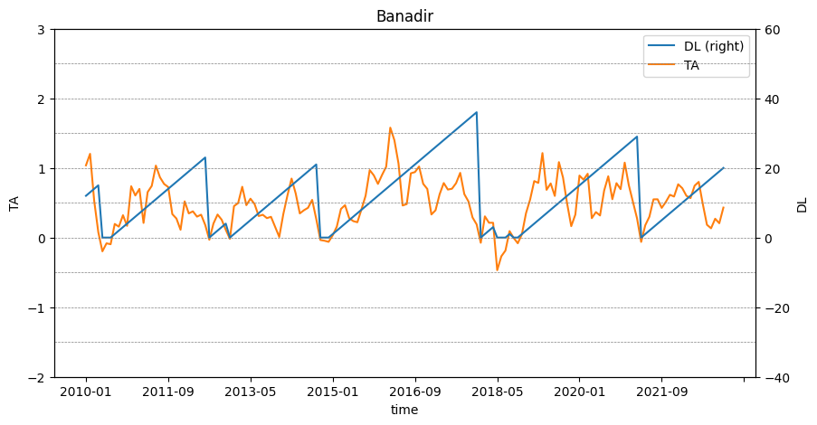
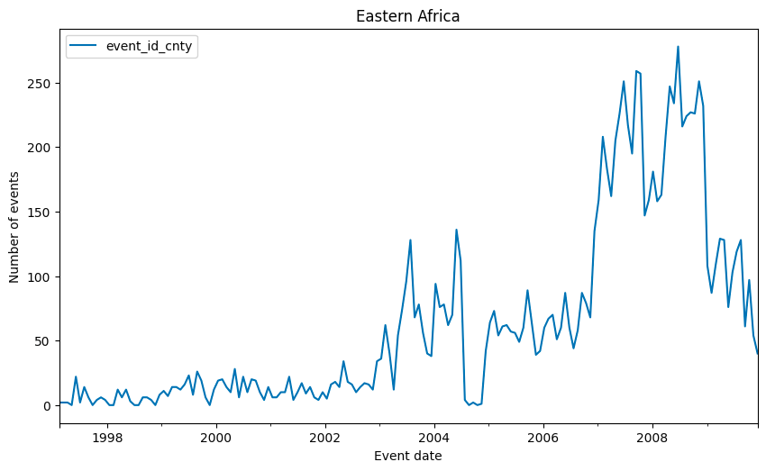
Weather, conflicts and IDPs in Somalia

Slide 3
Data
Extreme weather → temperature and precipitation anomalies, sourced from University of East Anglia Climatic Research United (UEA-CRU 2011)
Conflict data → Armed Conflict Location and Event Data Project (ACLED) database, which records violent conflict events
Displacement data → Protection and Return Monitoring Network (PRMN) survey, collected by the United Nations High Commissioner for Refugees (UNHCR)

Slide 4
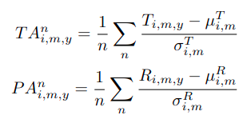
Variables
we transformed the gridded temperature data into a single, centered data point for each administrative unit
computed the long-term averages for each region and each month
computed the standardized difference with the maximum temperature for each region and for each month
calculated a moving average of these standardized values over a three-month window
Drought Lenght variable is defined as the number of consecutive months with positive temperature anomalies.

Slide 5
Reduced-form regression

Slide 6

Spatial Lag Model
SAR model
SARAR model

Slide 7
Spatial Lag Model
spatial weight matrix Wi is modeled as a:
adjacency matrix, where neighbouring regions weight 1 and the rest 0. This choice is motivated by the fact that regions in direct proximity have a greater influence compared to those situated at greater distances.
normalised inverse distance matrix, calculated between the centroids of the regions. This is to model an influence that decreases over space but is still accounted for in non neighbouring regions.

Slide 8
Population density
We incorporate population density as a control variable.
This decision is driven by the consideration that conflicts are more prone to arise in densely populated areas.
This choice aligns with our use of the absolute number of conflicts as the dependent variable, rather than conflicts per capita.

Slide 9
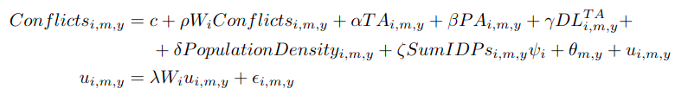
Internal displacements
SAR
SARAR

Slide 10
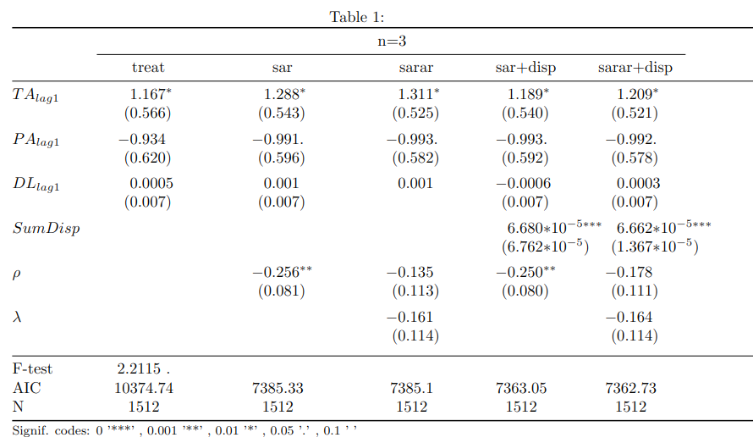
Results

Slide 11
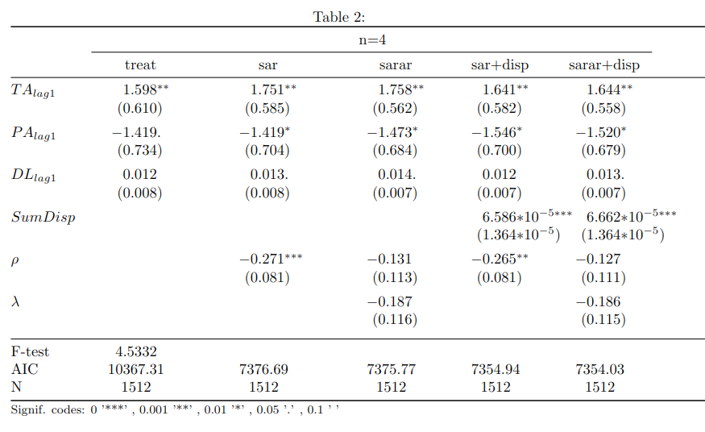
Results

Slide 12
Figures

Slide 13
New ideas?
Network analysis of displacements https://openknowledge.worldbank.org/server/api/core/bitstreams/2d2d931a-09c4-5b44-b1c1-67f19e3de6bd/content
Separable Temporal Exponential Random Graph Model (STERGM)
Keep linear regression model, but:
  Two-stage least-squares fixed-effect model (like Maystadt)
  Instrumental variable approach
Enlarge the area under study to neighboring countries and/or
Enlarge the time frame (they only study 2016-2018)
Go to Admin2 level
...

